Slide 1
Final Mini Project Proposal
Urban Change Detection Using Siamese U-Net on Satellite Imagery
Team: Laura Li, Maggie Tu, Alara Kaymak

Slide 2
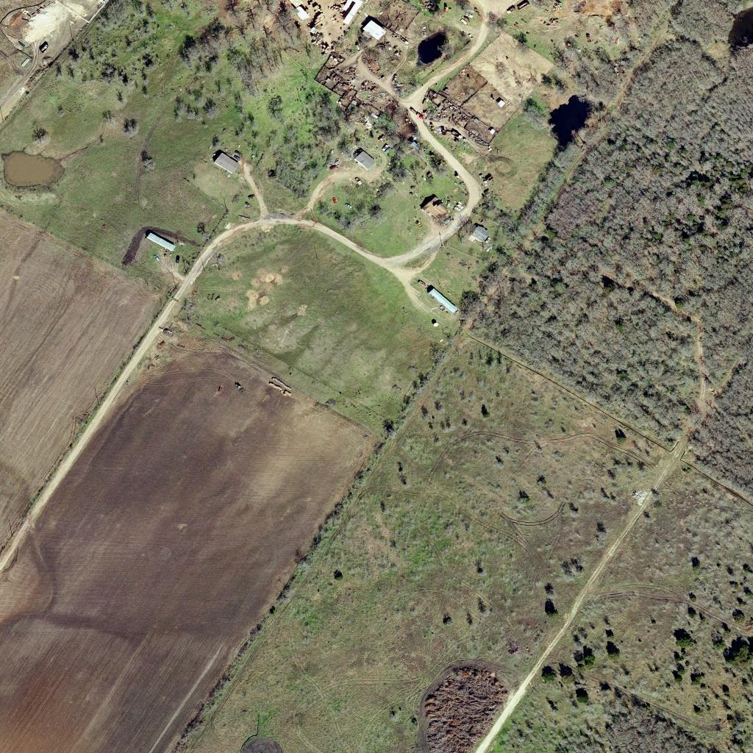
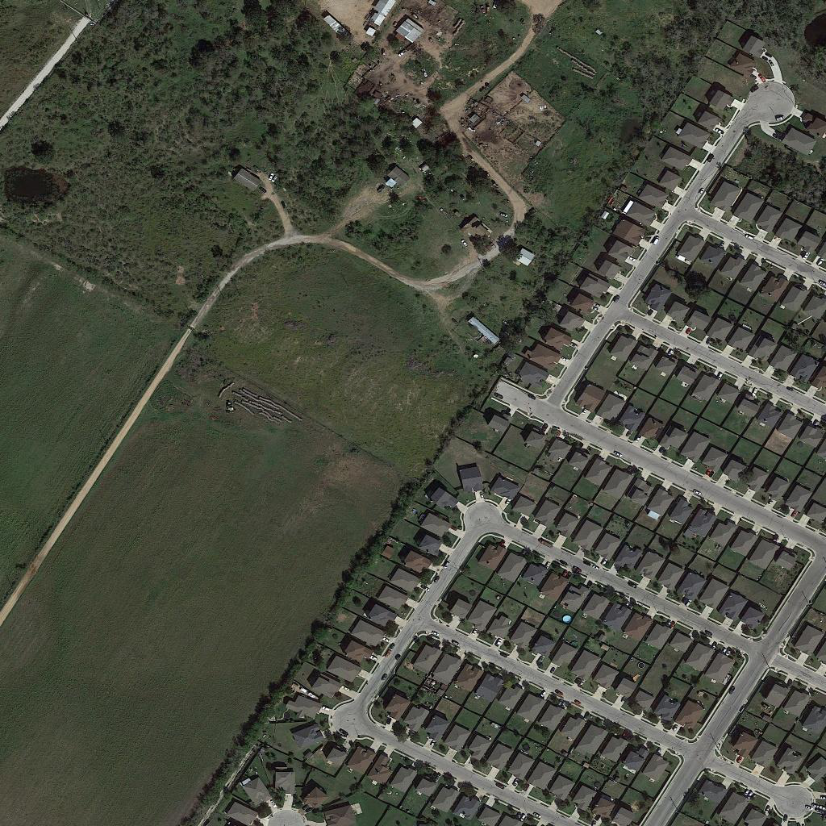
Problem
Cities change constantly through construction, demolition, and land-use modifications. These changes need to be monitored to support:
Urban planning
Infrastructure maintenance
Disaster response
Manual inspection of satellite imagery is slow and expensive. Automated change detection provides an efficient way to identify where significant changes occur between two different time periods.
Before
After

Slide 3
Challenges
Subtle or small changes can be difficult to detect
High variability in urban scenes (lighting, seasonal differences, shadows)
Precise pixel-level localization is required
Siamese networks require strong alignment between image pairs
Risk of overfitting due to large variations and limited labeled change pixels

Slide 4
Method
We will implement Siamese U-Net with shared encoder weights.
Pipeline:
Input: Two satellite images of same location (T1, T2)
Feature extraction with a shared U-Net encoder
Decoder merges the differences to predict a binary change mask
Baseline: Standard U-Net
Proposed upgrades:
Siamese architecture for temporal comparison
Loss functions tuned for imbalanced labels (Dice + BCE)
Evaluation using IoU, F1, Precision, and Recall

Slide 5
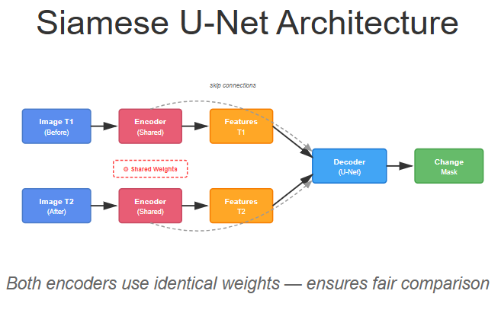

Slide 6
Data
Dataset: LEVIR-CD 🛰️
High-resolution satellite images (512×512 crops)
637 image pairs
21,000+ annotated building changes
Links:
Dataset — https://justchenhao.github.io/LEVIR/
Model reference — https://github.com/qubvel/segmentation_models
Labels: Binary masks showing where new structures appeared or old ones were removed.

Slide 7
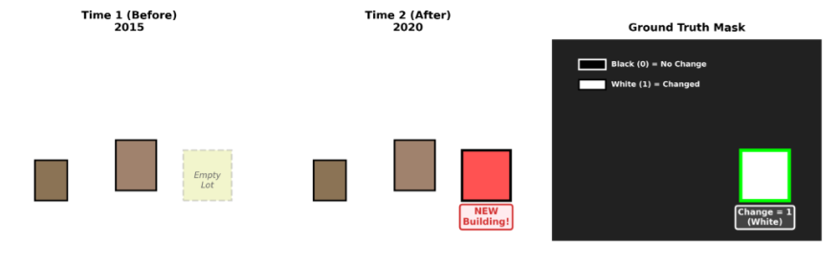
Example

Slide 8
Expected Outcome
A trained Siamese U-Net model capable of detecting urban development
Quantified performance using:
IoU, F1 score, Precision, Recall
Clear visualization of detected change regions
Stretch goal: Compare with state-of-the-art change detection methods

